Slide 1


Principles, Patterns, & Prism
James Kovacs
JamesKovacs.com
jkovacs@post.harvard.edu
Bil Simser
weblogs.asp.net/bsimser
emailme@bilsimser.com

Slide 2


Slide 3


Slide 4


Slide 5
Challenges of Complex Apps
How do multiple teams coordinate?
How is look and feel standardized?
How is new functionality added?
How is existing functionality modified?
How is separation of concerns facilitated?
How is the app tested?
How is the app deployed and versioned?

Slide 6
Composite Apps Are One Answer
Composed of discrete, independent pieces
Integrated within a host environment
Host environment mediates interactions
A coherent solution

Slide 7

Introducing Prism

Slide 8
StockTraderRI
Demo

Slide 9
Key Benefits
Composition of UI components in a coherent manner
Facilitates Application modules developed in an independent, loosely-coupled, and testable fashion
Facilitates separation of teams and responsibilities
Reduces cost of developing and maintaining long term
Notes:
Wordsmith further – increase understanding

Slide 10
Core Concepts
Events/Commands
Regions
Modules
Bootstrapper
Views
Services and Container
Notes:
Fade out the concepts we are not covering
Allow them to unfold

Slide 11
Composite UI
Host for all visual components that are loaded within the application
Shell
+Execute
Unit of deployment that is dynamically loaded by the shell.
Module
Responsible for laying out views. Can be statically or dynamically added to the shell
+Execute
Layout
UI Rendering of application data. Views provide by read/write and read-only access to data.
+Execute
View
+Execute
+Execute
Layout
View

Slide 12
StockTraderRI
Code Walk-through

Slide 13
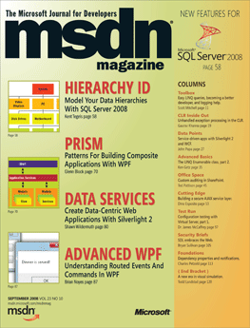

Slide 14
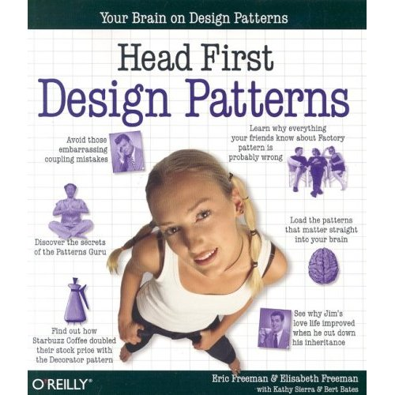

Slide 15
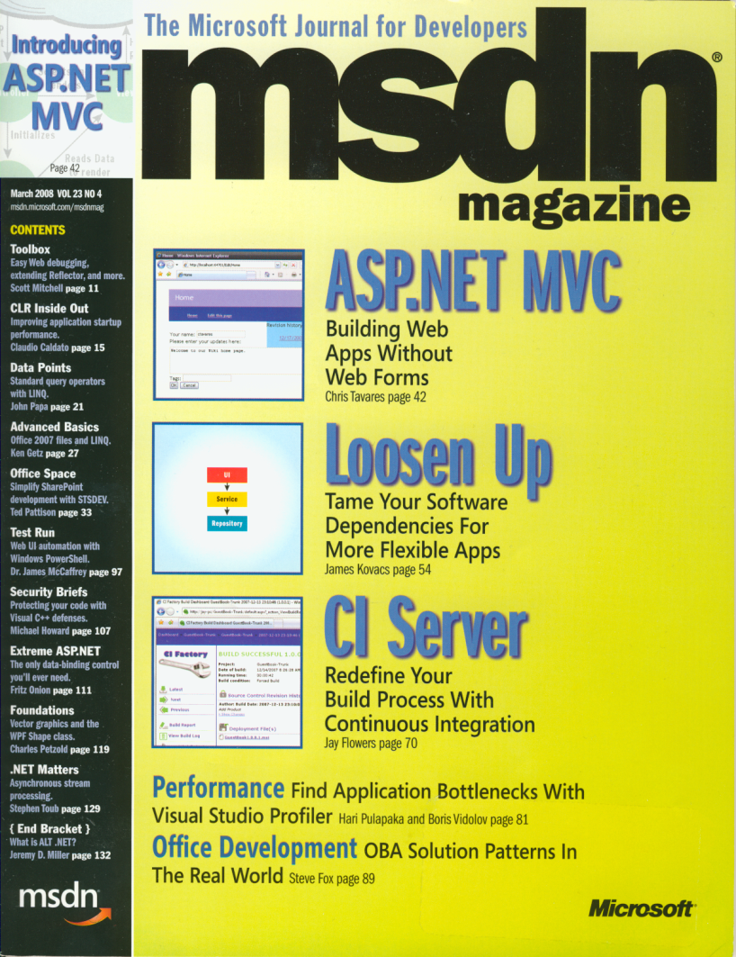

Slide 16
Resources
Composite WPF and Silverlight (aka Prism)
  http://www.codeplex.com/CompositeWPF
Composite WPF Contrib
  http://www.codeplex.com/CompositeWPFContrib
White
  http://www.codeplex.com/white
Prism: Patterns for Building Composite Applications with WPF, MSDN Magazine September 2008
  http://msdn.microsoft.com/en-us/magazine/cc785479.aspx
Loosen Up: Tame Your Software Dependencies for More Flexible Apps, MSDN Magazine March 2008
  http://msdn.microsoft.com/en-us/magazine/cc337885.aspx

Slide 17
Questions
James Kovacs
JamesKovacs.com
jkovacs@post.harvard.edu
Bil Simser
weblogs.asp.net/bsimser
emailme@bilsimser.com

